Slide 1


Appalachian Labor Markets:
Preparing for Jobs of the Future
DSPG Summer 2021
Fellow: Tim Pierce
Interns: Austin Burcham, Ryan Jacobs
Faculty: Susan Chen, Anubhab Gupta, Andrew Katz

Slide 2

An Overview of Appalachia
Breakdown:
13 States
420 Counties
Population: ≈ 25,717,174
9.9% Black
5.4% Hispanic
3.9% Other
Poverty Rate:
16.3%
Median Age:
41.3
Median Household Income
$51,916 (82.6% of US)
Sources: 2019 ACS 5 Year Estimates: https://data.census.gov/cedsci/table?q=b01003&tid=ACSDT1Y2019.B01003
Appalachian Regional Commission: https://www.arc.gov/about-the-appalachian-region/

Slide 3
Appalachian Labor Markets
Concerns
Infrastructural changes with economic transition to clean power
Imperfect labor market information
Systematic disadvantages in upward mobility
Questions
What jobs and skills currently exist in Appalachia?
What sustainable industries and occupations will emerge?
What jobs are most viable for the Appalachian Labor Market?

Slide 4
Project Goals
Quantify and visualize skills and characteristics of the Appalachian Labor Market
Identify the skills, education, and preparation required for sustainable jobs and “jobs-of-the-future”
Quantify the gap between current skills in the labor market and the skills required for “jobs-of-the-future”
Understand potential bottlenecks to bridging the gap between current skills and skills required for “jobs-of-the-future.”

Slide 5
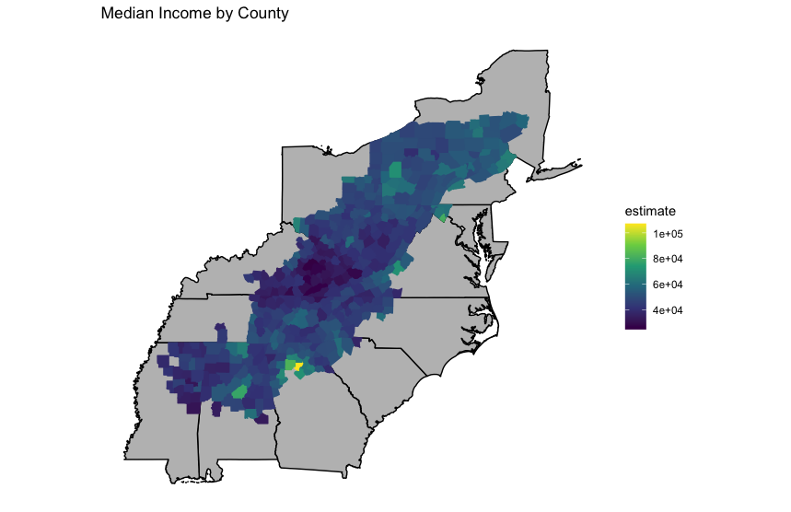
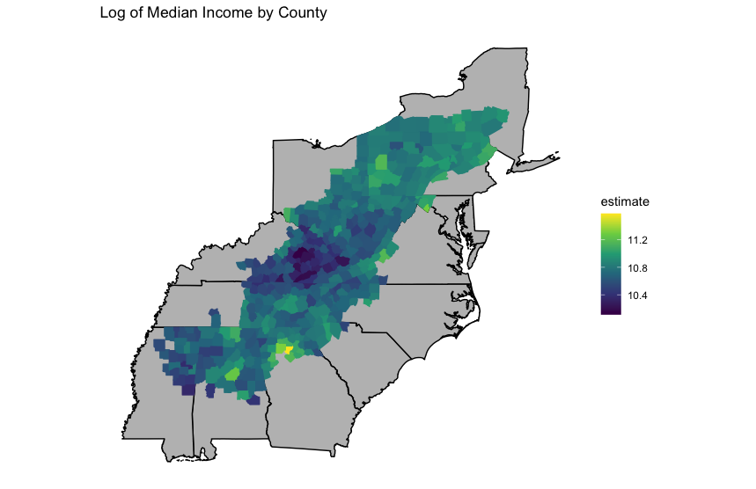
Age and Income
Source: 2019 American Community Survey (ACS) 5-year estimates, found at: https://data.census.gov/cedsci/table?q=S0101&tid=ACSST1Y2019.S0101
https://data.census.gov/cedsci/table?q=median%20income&tid=ACSST1Y2019.S1901

Slide 6
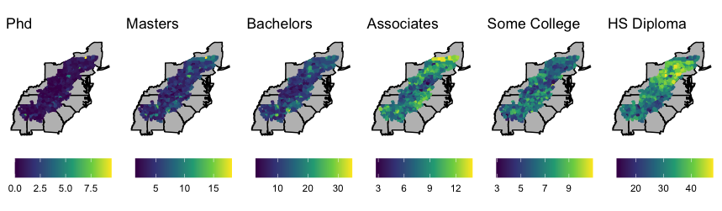
Education
Source: 2019 American Community Survey (ACS) 5-year estimates, found athttps://data.census.gov/cedsci/table?q=b15003&tid=ACSDT1Y2019.B15003

Slide 7
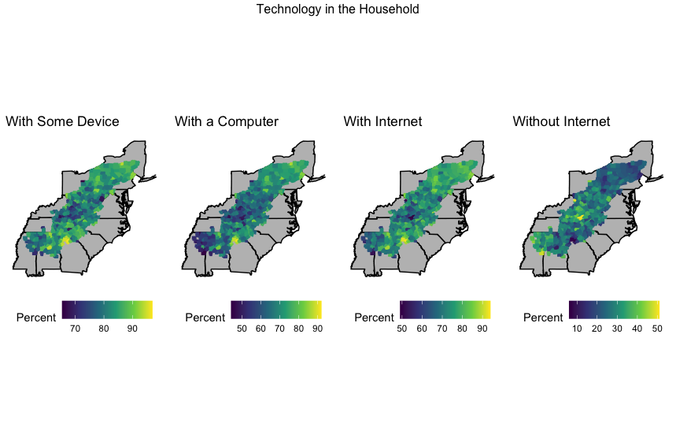
Technology and Broadband Access
Source: 2019 American Community Survey (ACS) 5-year estimates, found at:
https://data.census.gov/cedsci/table?q=broadband&tid=ACSST1Y2019.S2801

Slide 8
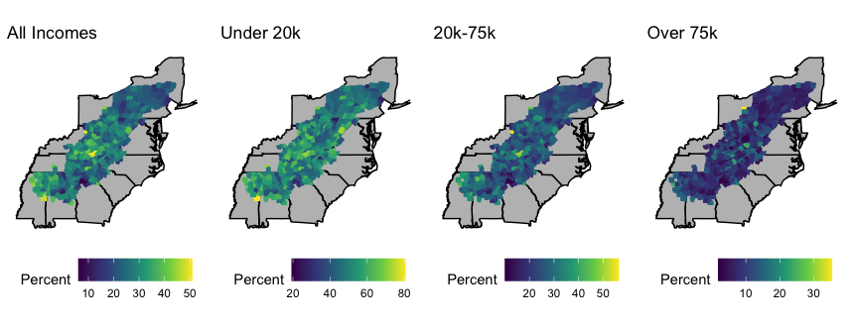
Households without Internet Subscriptions
Source: 2019 American Community Survey (ACS) 5-year estimates, found at:
https://data.census.gov/cedsci/table?q=broadband&tid=ACSST1Y2019.S2801

Slide 9
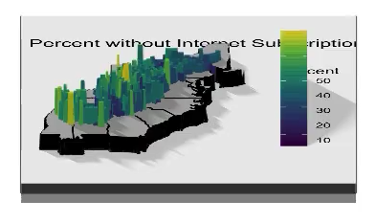
Households without Internet Subscriptions
Source: 2019 American Community Survey (ACS) 5-year estimates, found at:
https://data.census.gov/cedsci/table?q=broadband&tid=ACSST1Y2019.S2801

Slide 10
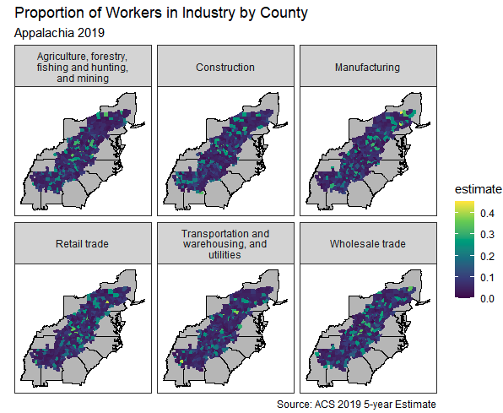
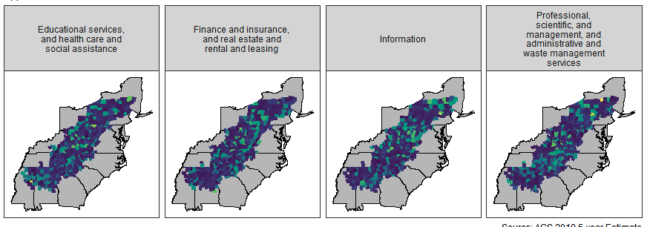
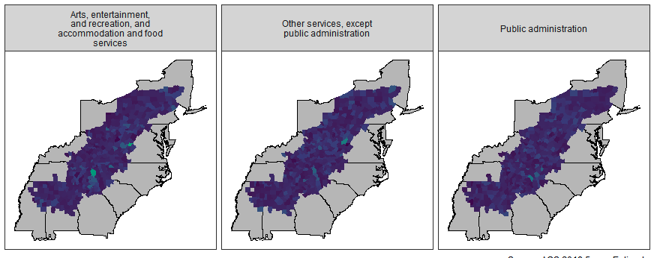
Industry Type by County
Source: American Community Survey (ACS) from the U.S. Census Bureau, found at: https://data.census.gov/cedsci/table?q=CBP2019.CB1900CBP&tid=CBP2019.CB1900CBP&hidePreview=true

Slide 11
Next Steps
Explore options to connect our industry data to O-Net skills data
Utilize web scraping and natural language processing to understand the skills required for sustainable jobs (via O-Net)
Wait patiently for something to happen with the Bipartisan Infrastructure Bill
Hopefully gain a better understand the future of coal-dependent region
Potentially: aggregate block level data to perform regression analyses

Slide 12
Upcoming Challenges and Questions
Obtaining reliable data from counties with very low populations
Connecting skills associated with occupations to jobs in counties
Identifying jobs of the future:
Web scraping can only find openings that make it to the web!
Identifying which jobs of the future are viable for Appalachian counties

Slide 13
Questions?

